Slide 1
The Routing Table: A Closer Look
Routing Protocols and Concepts – Chapter 8

Slide 2
Objectives
Describe the various route types found in the routing table structure
Describe the routing table lookup process.
Describe routing behavior in routed networks.

Slide 3
Introduction
Chapter Focus
In this chapter, we will take a closer look at the routing table.
The first part of the chapter focuses on the structure of Cisco's IP routing table.
We will examine the format of the routing table and learn about level 1 and level 2 routes.
The second part of the chapter analyzes the lookup process of the routing table. We will discuss classful routing behavior, as well as classless routing behavior, which uses the no ip classless and ip classless commands.

Slide 4
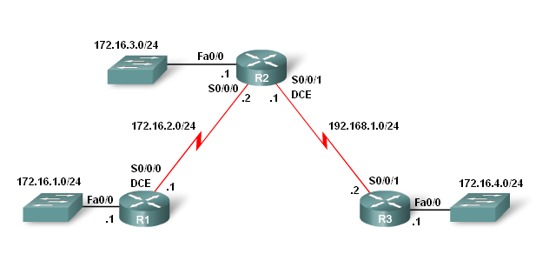
Topology Example

Slide 5
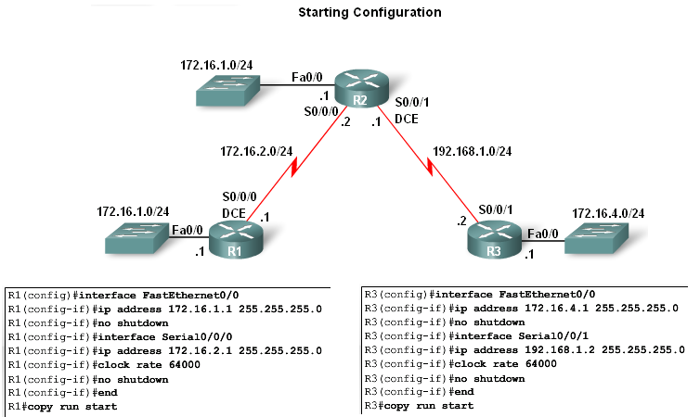
Routing Table Structure
Lab Topology
3 router setup
  -R1 and R2 share a common 172.16.0.0/16 network with 172.16.0.0/24 subnets.
  -R2 and R3 are connected by the 192.168.1.0/24 network.
  -R3 also has a 172.16.4.0/24 subnet, which is disconnected, or discontiguous, from the 172.16.0.0 network that R1 and R2 share.

Slide 6
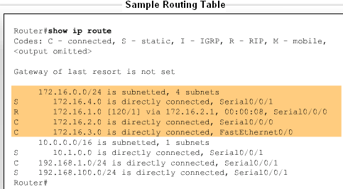
Routing Table Structure
Routing table entries come from the following sources
  -Directly connected networks
  -Static routes
  -Dynamic routing protocols

Slide 7
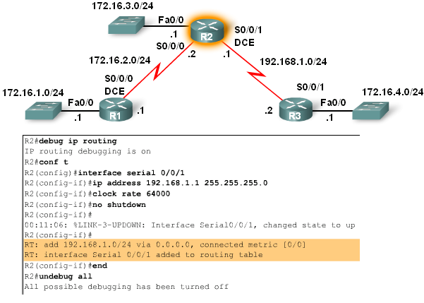
Routing Table Structure
Level 1 Routes
As soon as the no shutdown command is issued the route is added to routing table

Slide 8
Level 1 or Level 2?
The Cisco IP routing table is not a flat database.
The routing table is actually a hierarchical structure that is used to speed up the lookup process when locating routes and forwarding packets.
Within this structure, the hierarchy includes several levels. For simplicity, we will discuss all routes as one of two levels: level 1 or level 2.
A level 1 route is a route with a subnet mask equal to or less than the classful mask of the network address.
192.168.1.0/24 is a level 1 network route, because the subnet mask is equal to the network's classful mask. /24 is the classful mask for class C networks, such as the 192.168.1.0 network.

Slide 9
Level 1 Route
A level 1 route can function as a:
Default route - A default route is a static route with the address 0.0.0.0/0.
Supernet route - A supernet route is a network address with a mask less than the classful mask.
Network route - A network route is a route that has a subnet mask equal to that of the classful mask. A network route can also be a parent route. Parent routes will be discussed in the next section.

Slide 10
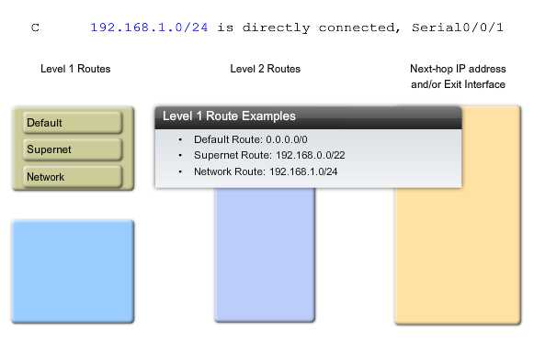
Examples

Slide 11
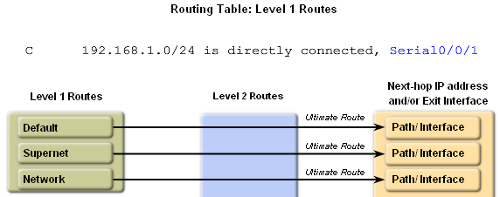
Routing Table Structure
Level 1 Routes
  -Ultimate Route
    Includes either:
-A next-hop address
OR
-An exit interface

Slide 12
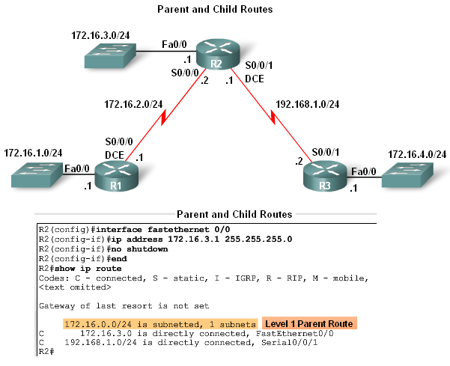
Routing Table Structure
Parent and Child Routes
-A parent route is a level 1 route
-A parent route does not contain any next-hop IP address or exit interface information

Slide 13
Parent Route
A level 1 parent route is a network route that does not contain a next-hop IP address or exit interface for any network.
A parent route is actually a heading that indicates the presence of level 2 routes, also known as child routes.
A level 1 parent route is automatically created any time a subnet is added to the routing table.
In other words, a parent route is created whenever a route with a mask greater than the classful mask is entered into the routing table.
The subnet is the level 2 child route of the parent route. In this case, the level 1 parent route that was automatically created is: 172.16.0.0/24 is subnetted, 1 subnets
172.16.0.0/24 is subnetted, 1 subnets

Slide 14
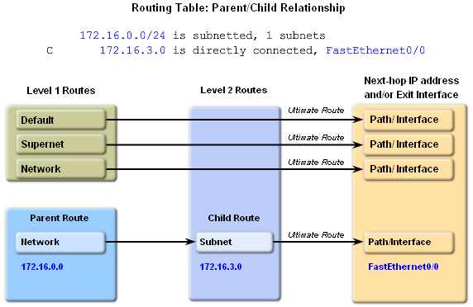
Routing Table Structure
Automatic creation of parent routes
  -Occurs any time a subnet is added to the routing table
Child routes
-Child routes are level 2 routes
-Child routes are a subnet of a classful network address

Slide 15
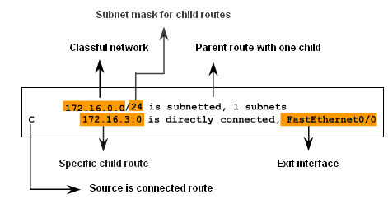
Routing Table Structure
Level 2 child routes contain route source & the network address of the route
Level 2 child routes are also considered ultimate routes
Reason: they contain the next hop address &/or exit interface

Slide 16
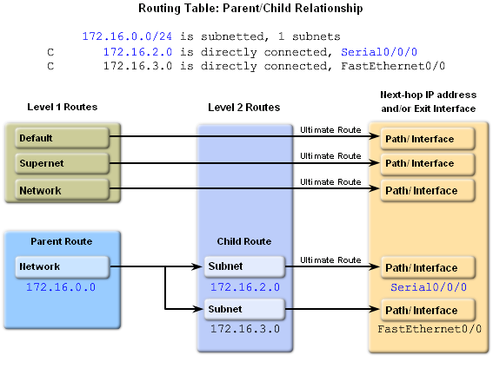
Routing Table Structure
Both child routes have the same subnet mask
-This means the parent route maintains the /24 mask

Slide 17
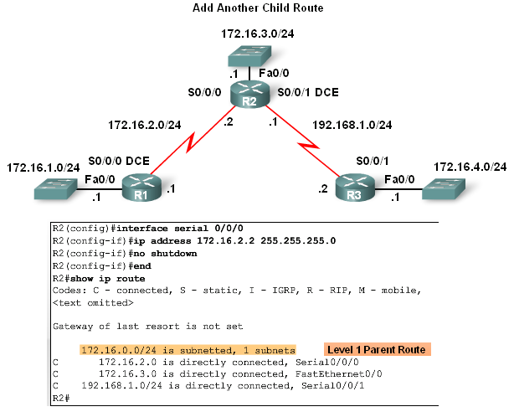
Routing Table Structure
Diagram illustrates 2 child networks belonging to the parent route 172.16.0.0 / 24

Slide 18
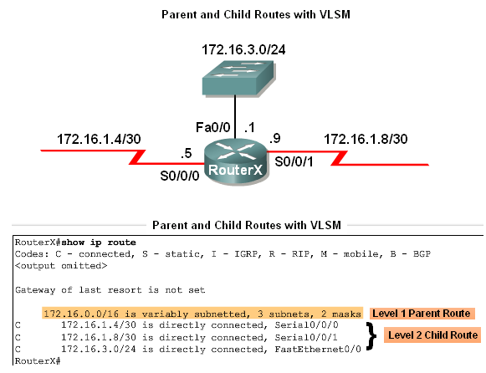
Routing Table Structure
In classless networks, child routes do not have to share the same subnet mask

Slide 19
Classless Routes
Whenever there are two or more child routes with different subnet masks belonging to the same classful network, the routing table presents a slightly different view, which states that this parent network is variably subnetted.
Although the parent/child relationship uses a classful structure to display networks and their subnets, this format can be used with both classful and classless addressing.
Regardless of the addressing scheme used by the network (classless or classful), the routing table will use a classful scheme.

Slide 20
Routing Table Structure
Parent & Child Routes: Classless Networks
Network Type | Parent route’s Classful mask is Displayed | Term variably subnetted is seen in parent route in routing table | Includes the # of different masks of child routes | Subnet mask included with each child route entry
Class- ful | No | No | No | No
Class-less | Yes | Yes | Yes | Yes

Slide 21
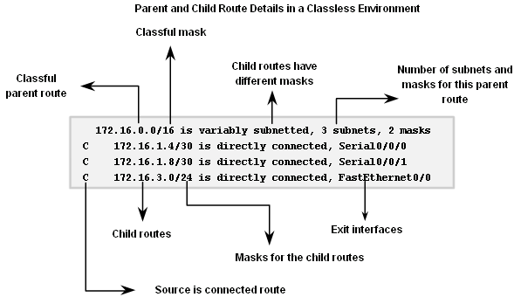
Routing Table Structure
Parent & Child Routes: Classless Networks

Slide 22
Route Lookup Process
What happens when a router receives an IP packet, examines the IP destination address, and looks that address up in the routing table?
How does the router decide which route in the routing table is the best match?
What effect does the subnet mask have on the routing table lookup process?
How does the router decide whether or not to use a supernet or default route if a better match is not found?

Slide 23
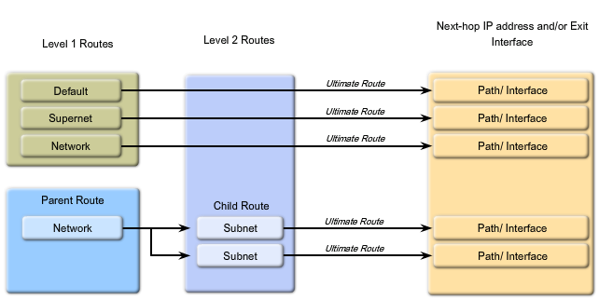
Router Lookup Process

Slide 24
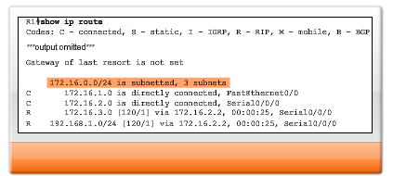
Routing Table

Slide 25
Routing Table Lookup Process
The Route Lookup Process
    Examine level 1 routes
      -If best match at level 1 ultimate route and is not a parent route this route is used to forward packet
    Router examines level 2 (child) routes
      -If there is a match with level 2 child route then
        that subnet is used to forward packet
      -If no match then
      determine routing behavior type
    Router determines classful or classless routing behavior
      -If classful then
        packet is dropped
      -If classless then router searches level one supernet and default routes
      -If there exists a level 1 supernet or default route match then Packet is forwarded. If not packet is dropped

Slide 26
Longest Match
First of all, what is a match? For there to be a match between the destination IP address of a packet and a route in the routing table, a minimum number of left-most bits must match between the IP address of the packet and the route in the routing table.
The subnet mask of the route in the routing table is used to determine the minimum number of left-most bits that must match. (Remember, an IP packet only contains the IP address and not the subnet mask.)
The best match or longest match is the route in the routing table that has the most number of left-most matching bits with the destination IP address of the packet.
The route with the most number of equivalent left-most bits, or the longest match, is always the preferred route.

Slide 27
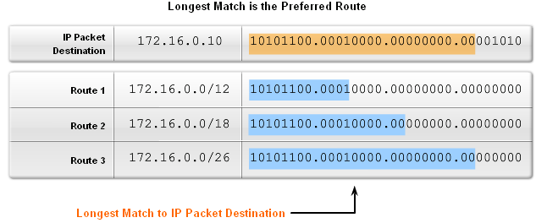
Routing Table Lookup Process
Longest Match: Level 1 Network Routes
  Best match is also known as the longest match
  The best match is the one that has the most number of left most bits matching between the destination IP address and the route in the routing table.

Slide 28
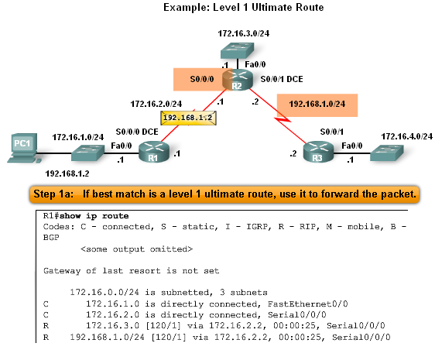
Routing Table Lookup Process
Finding the subnet mask used to determine the longest match
Scenario:
  PC1 pings 192.168.1.2
  Router examines level 1 route for best match
  There exist a match between192.168.1.2 & 192.168.1.0 / 24
  Router forwards packets out s0/0/0

Slide 29
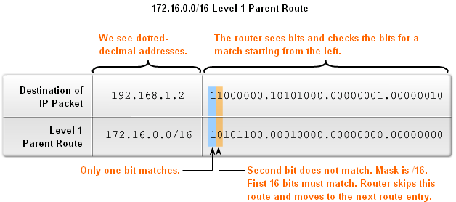
Routing Table Lookup Process
The process of matching
-1st there must be a match made between the parent route & destination IP
      -If a match is made then an attempt at finding a match between the destination IP and the child route is made.

Slide 30
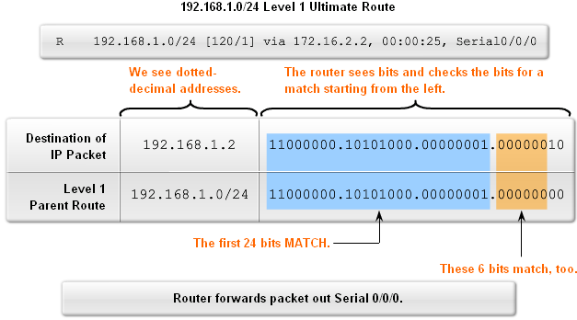
Routing Table Lookup Process
Finding a match between packet’s destination IP address and the next route in the routing table
-The figure shows a match between the destination IP of 192.168.1.0 and the level one IP of 192.168.1.0 / 24 then packet forwarded out s0/0/0

Slide 31
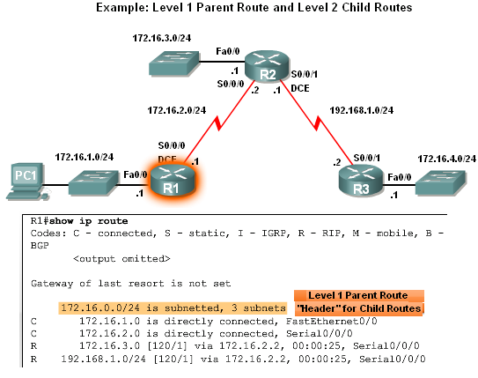
Routing Table Lookup Process
Level 1 Parent & Level 2 Child Routes
Before level 2 child routes are examined
-There must be a match between classful level one parent route and destination IP address.

Slide 32
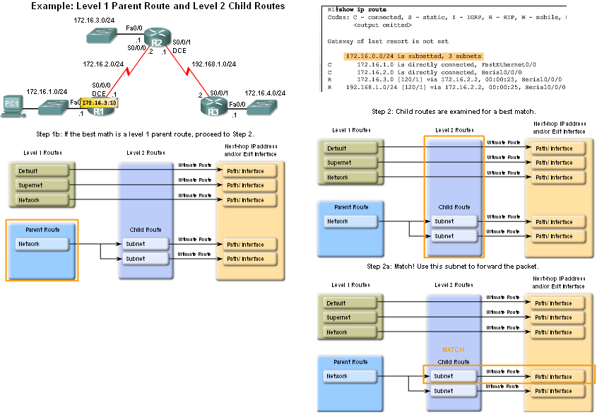
Routing Table Lookup Process
After the match with parent route has been made Level 2 child routes will be examined for a match
-Route lookup process searches for child routes with a match with destination IP

Slide 33
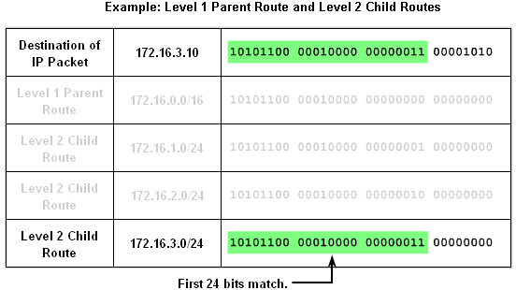
Routing Table Lookup Process
How a router finds a match with one of the level 2 child routes
-First router examines parent routes for a match
-If a match exists then:
        Child routes are examined
        Child route chosen is the one with the longest match

Slide 34
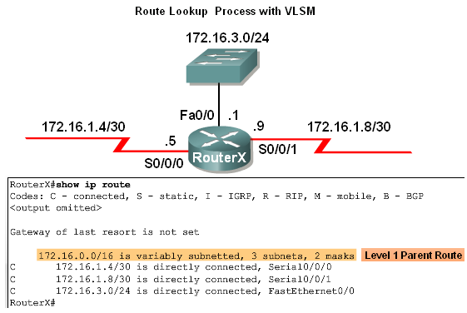
Routing Table Lookup Process
Example: Route Lookup Process with VLSM
-The use of VLSM does not change the lookup process
-If there is a match between destination IP address and the level 1 parent route then
-Level 2 child routes will be searched

Slide 35
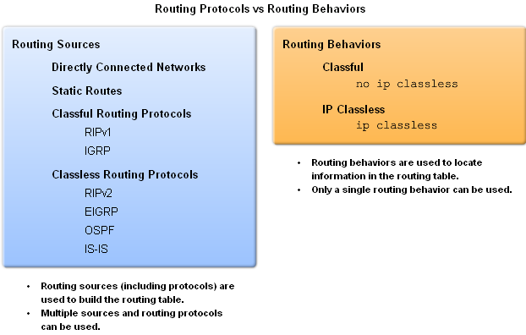
Routing Behavior
Classful & classless routing protocols
Influence how routing table is populated
Classful & classless routing behaviors
Determines how routing table is searched after it is filled

Slide 36
Routing Behaviours
Classless and classful routing behaviours are not the same as classless and classful routing protocols. Classful and classless routing protocols affect how the routing table is populated.
Classful and classless routing behaviours determine how the routing table is searched after it is populated.
The routing behaviour, specified by the ip classless or no ip classless commands, determines how the route lookup process will proceed at Step 3.
As you can see, routing protocols and routing behaviours are completely independent of each other.
The routing table could be populated with routes from a classless routing protocol like RIPv2 yet implement classful routing behaviour because the no ip classless command is configured.

Slide 37
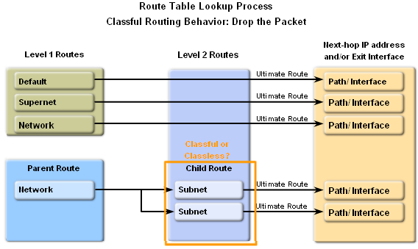
Routing Behavior
Classful Routing Behavior: no ip classless
What happens if there is not a match with any level 2 child routes of the parent?
-Router must determine if the routing behavior is classless or classful
-If router is utilizing classful routing behavior then
-Lookup process is terminated and packet is dropped

Slide 38
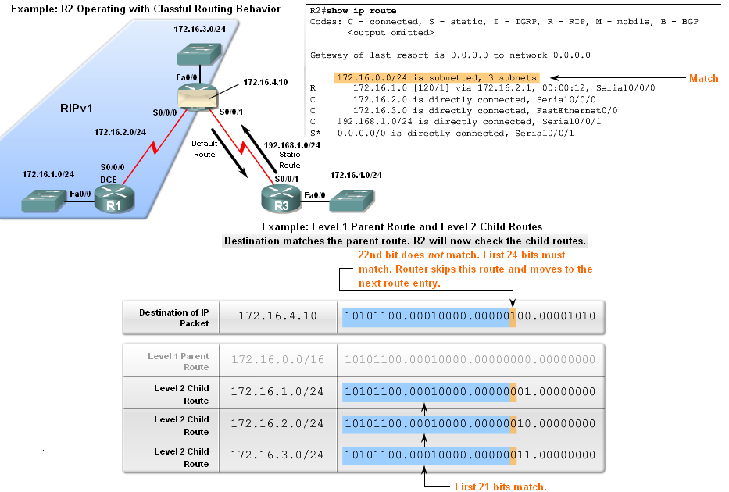
Routing Behavior
Classful Routing Behavior – Search Process
An example of when classful routing behavior is in effect and why the router drops the Packet
  -The destination’s subnet mask is a /24 and none of the child routes left most bits match the first 24 bits. This means packet is dropped

Slide 39
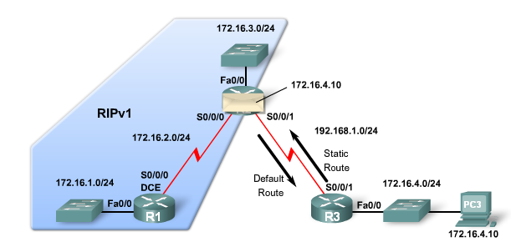
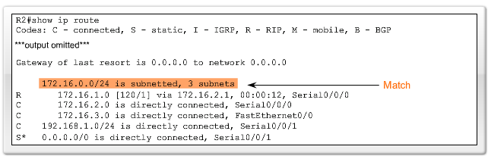
Examples

Slide 40
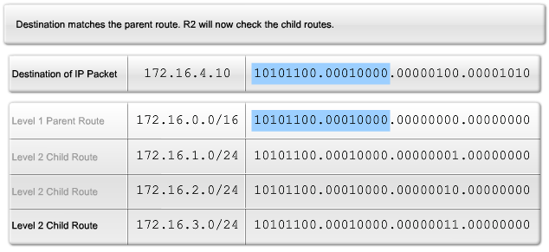
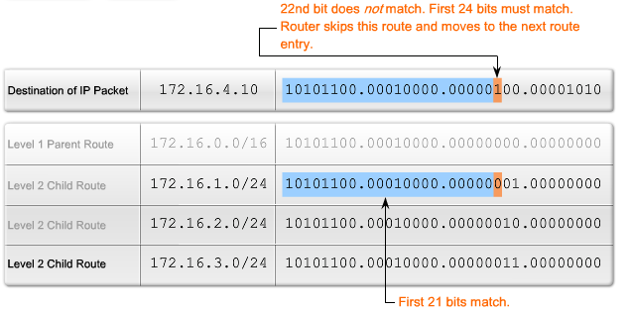
Matching the Packets

Slide 41
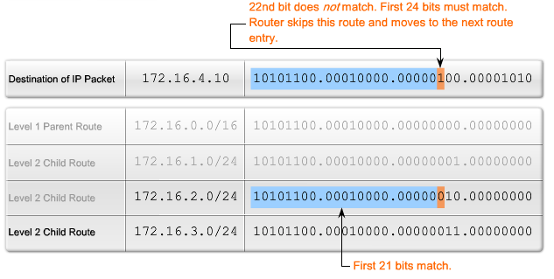
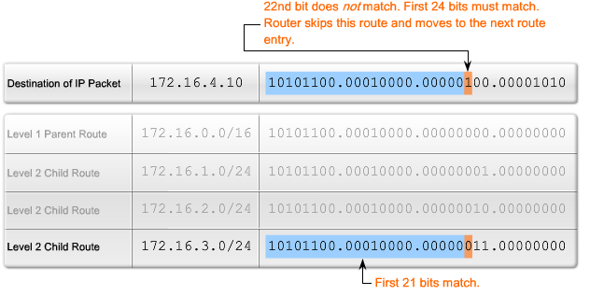

Slide 42
Routing Behavior
Classful Routing Behavior – Search Process
The reason why the router will not search beyond the child routes
        Originally networks were all classful
        This meant an organization could subnet a major network address and “enlighten” all the organization’s routers about the subnetting
        Therefore, if the subnet was not in the routing table, the subnet did not exist and packet was dropped

Slide 43
Routing Behavior
ip Classless
Beginning with IOS 11.3, ip classless was configured by default
Classless routing behavior works for
-Discontiguous networks
And
-CIDR supernets

Slide 44
Routing Behavior
Classless Routing Behavior: ip classless
Route lookup process when ip classless is in use
-If classless routing behavior in effect then
        Search level 1 routes
        Supernet routes Checked first
-If a match exists then forward packet
        Default routes Checked second
If there is no match or no default route then the
        Packet is dropped

Slide 45
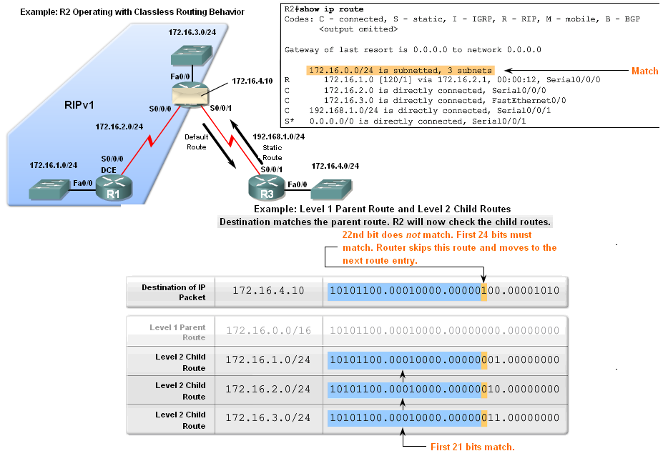
Routing Behavior
Classless Routing Behavior – Search Process
Router begins search process by finding a match between destination IP and parent route
After finding the above mentioned match, then there is a search of the child route

Slide 46
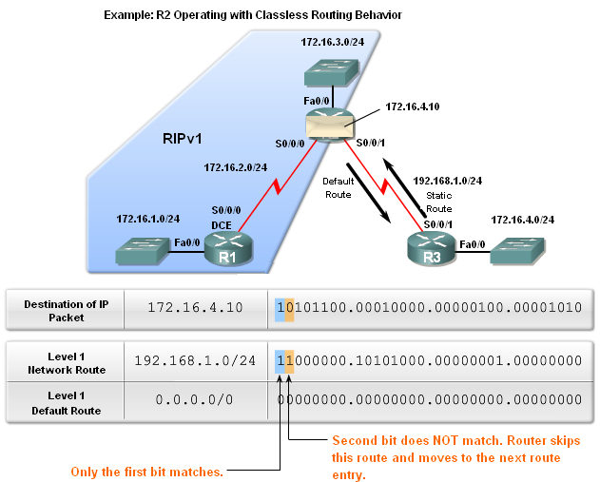
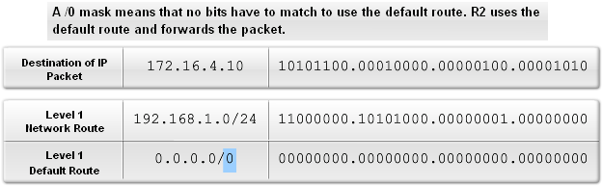
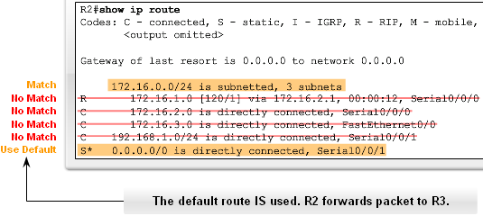
Routing Behavior
Classless Routing Behavior – Search Process
If no match is found in child routes of previous slide then
Router continues to search the routing table for a match that may have fewer bits in the match

Slide 47
Routing Behavior
Classful vs. Classless Routing Behavior
-It is recommended to use classless routing behavior
      Reason: so supernet and default routes can be used whenever needed

Slide 48
Summary
Content/structure of a routing table
Routing table entries
-Directly connected networks
-Static route
-Dynamic routing protocols
Routing tables are hierarchical
-Level 1 route
Have a subnet mask that is less than or equal to classful subnet mask for the network address
-Level 2 route
These are subnets of a network address

Slide 49
Summary
Routing table lookup process
Begins with examining level 1 routes for best match with packet’s destination IP
  If the best match = an ultimate route then
  -Packet is forwarded -Else-
  -Parent route is examined
  If parent route & destination IP match then Level 2 (child) routes are examined
  Level 2 route examination
  If a match between destination IP and child route found then Packet forwarded -Else
  If Router is using classful routing behavior then Packet is dropped -Else
  If router is using classless routing behavior then
  Router searches Level 1 supernet & default routes for a match
  If a match is found then Packet if forwarded -Else
  Packet is dropped

Slide 50
Summary
Routing behaviors
-This refers to how a routing table is searched
Classful routing behavior
-Indicated by the use of the no ip classless command
-Router will not look beyond child routes for a lesser match
Classless routing behavior
-Indicated by the use of the ip classless command
-Router will look beyond child routes for a lesser match

